Slide 1
What Can We Learn from Information Ethics for Modelling Information Interactions
Jela Steinerová
jela.steinerova@uniba.sk
Information Interactions 2022

Slide 2
Agenda and objectives
Ethical issues of models of human information behaviour and information literacy
  Which ethical factors can enrich these models?
    Basic concepts (HII, HIB, IE, IL)
    Related research: selected models (dis/misinformation, ethical factors)
Our study: information ethics in digital environment: a Delphi study
  A model of social representations of ethical challenges of information use
Recommendations for theory, information design and practice

Slide 3
Human information interactions
Mutual influences between information and people in the information environment: adaptations, cultivation of the information environment
Relationships between people and information in contexts (Steinerová 2020, Fidel 2012, Marchionini 2008)
  Human information behaviour: muti-level human integrated activity in relation to work with information (processing, creation, seeking, use)
  Information literacy: a set of knowledge, experience, skills and efficient information practices in information use (related to the information process) (Steinerová 2020)

Slide 4
Information ethics
A transdisciplinary area of information science, based on the use of philosophical ethics, information technologies, media etc., focus: values of information, access, property, privacy, accuracy, communication
  Ethical models and concepts: L. Floridi (2013), R. Capurro (2019) etc.
  A system of moral values in the context of human information interactions
  Structure: virtue ethics, ethics of consequentialism, ethics of utilitarism, ethics of caring about the information environment
    Critical reflection and empirical studies, analytical and normative frameworks

Slide 5
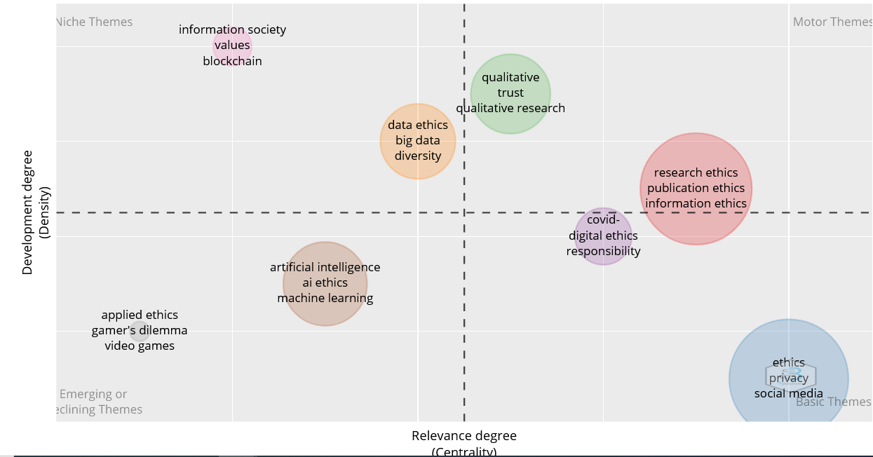
Information ethics: topical bibliometric analysis (author keywords), WoS, 2019-2022

Slide 6
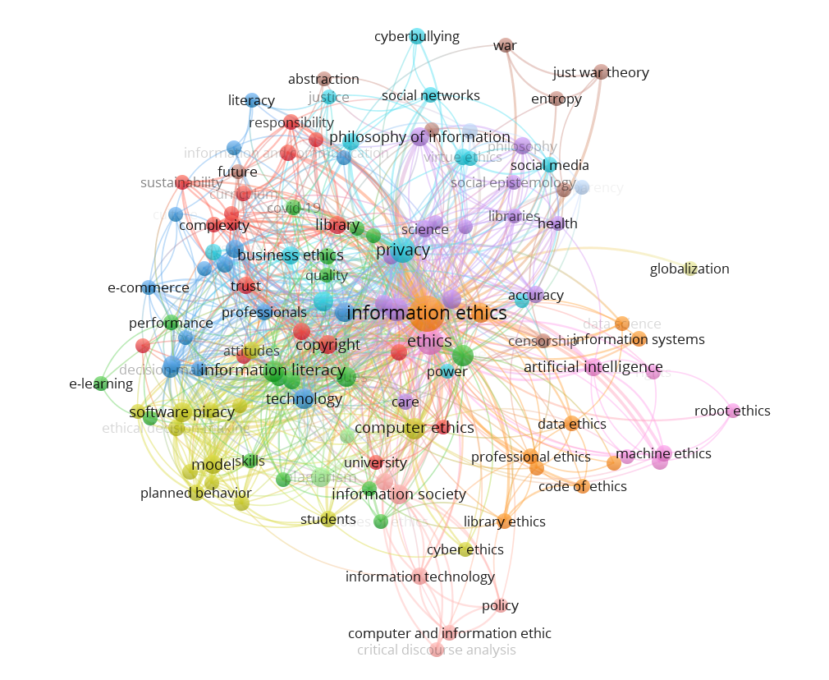
Bibliometric analysis: Keywords in abstracts, WoS, (461 rec.), 1988-2021

Slide 7
A taxonomy of information ethics topics
Topics/facets of information ethics | Manifestations in information behaviour and practices and information literacy
Access to information Information behaviour and practices, information literacy Information interactions Searching/mapping Information strategies Information use, experience Information acquisition | Ethical awareness of information sources Ethical information experience Contexts of time and place Ethical reasoning, decision-making, imagination Affective, cognitive, sensorimotor interactions Ethical intuitions
Accuracy of information Social perception of information Discernment of disinformation/misinformation Critical thinking Biased information assessment Social diffusion of information Errors, incompleteness of information | Relevance assessment Ethical reasoning Categorization of information Constructing truth, topics Verification of information, fact-checking Constructing values of information (truth, utility) Ethical intuitions
Property Rules, principles (informal) Codices (professional) Intellectual property rights (laws, copyright law) Ownership (laws, rules) | Ethical/fair use Awareness of rules and ethical codices Adherence to rules, academic integrity, citation cultures Ethical reasoning, decision-making, responsibility
Privacy and data Data protection/personal data Security, information security Risks of digital environment Big data (mining), AI | Data/(big data) ethics Fair, informed interpretations Awareness of security, risks Informed algorithms/ethics of AI, data literacy
Communities Social diffusion of information Online communication Collaboration, cooperation Information sharing Rules of cultures/communities/institutions | Ethical rules of communities (social frameworks) Ethical intuitions, knowledge of rules and cultures, patterns Ethical imagination, ethical reasoning, decision-making Ethical self-reflections
Ownership

Slide 8
Ethical challenges of digital information use
Structure:
  Property (copyright, intellectual property rights)
  Access (information technologies, sources, ethics of AI, information security)
  Privacy (personal data)
  Accuracy (dis/misinformation, values of information)
  Communities (communication, information sharing, collaboration)
  Data (data ethics)
Challenges for research: information ecology and information ethics, ecological aspects of information literacy (Steinerová 2010, 2022)

Slide 9
Related research: models of HIB and IL
Selected models of human information behaviour: ethical issues: accuracy: dis/misinformation, privacy, access, communication
Selected models of information literacy: ethical issues: moral literacy, model ANCIL, metaliteracy: property, values, critical thinking, truth, dis/misinformation

Slide 10
A model of HIB: social diffusion of dis/misinformation, Karlova and Fisher 2014

Slide 11
A model of HIB: social perception, Ruokolainen, Widén 2020

Slide 12
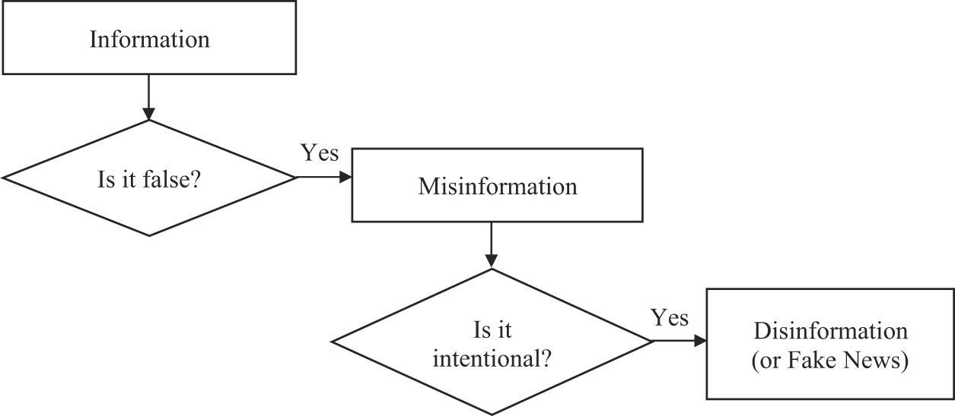
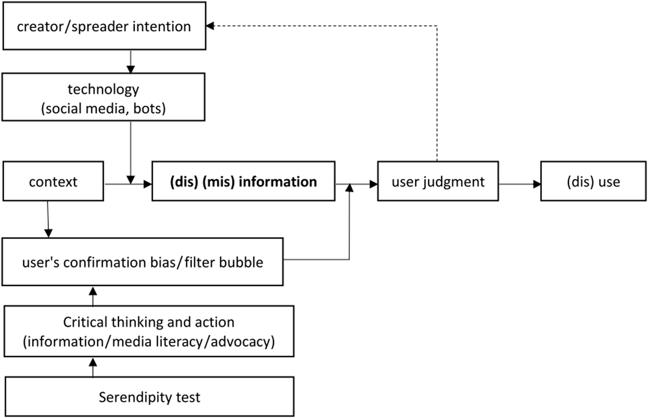
A causal, integrated model of HIB, Agarwal 2021
The process: the simplified causal model (how to fight with dis/misinformation)
Fake news, dis/misinformation

Slide 13
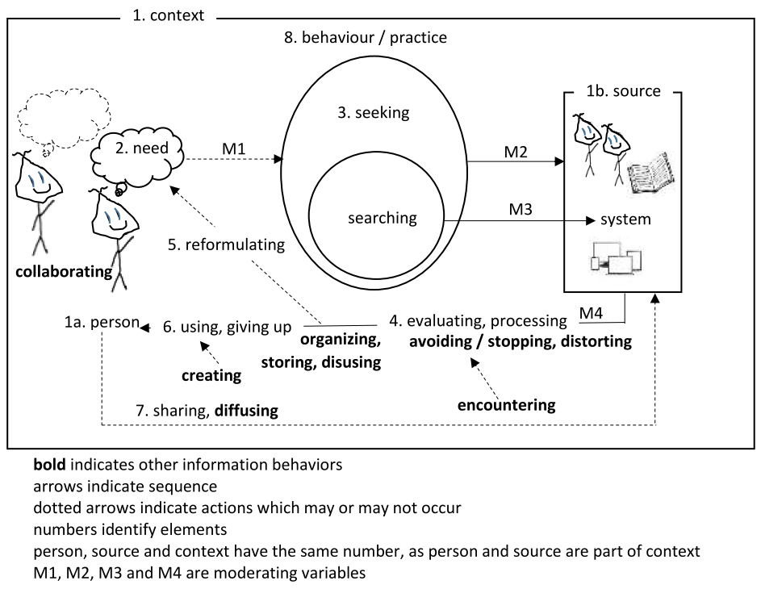
Unified, integrated models of HIB, Agarwal 2022
HIB models: 1985-1999, 2000-2013, 2014-2022

Slide 14
Ethical issues and human information behaviour
Value-sensitive human information behaviour
  Ethical information seeking: relevance assessment
  Social perception of information / dis/misinformation
  Social diffusion of information / dis/misinformation
Ethical information use:
  Ethically informed decision-making
  Ethically informed problem-solving
Ethical awareness of the information resources and information environment (ethics of knowlege organization, professional codices)
Ethical sensitivity in information production and use (citation culture, etc.)

Slide 15
Ethical issues and information literacy
Tuana 2007: moral literacy
  ACRL IL Framework (2016)
  Forster 2013: ethical issues of information literacy
ANCIL – Secker, Coonan 2013: A New Curriculum of Information Literacy (ANCIL model)
MacKay, Jacobson 2014, 2019: Metaliteracy (model)

Slide 16
Tuana (2007): moral literacy

Slide 17
Model: components of information literacy (Tuana 2007)

Slide 18
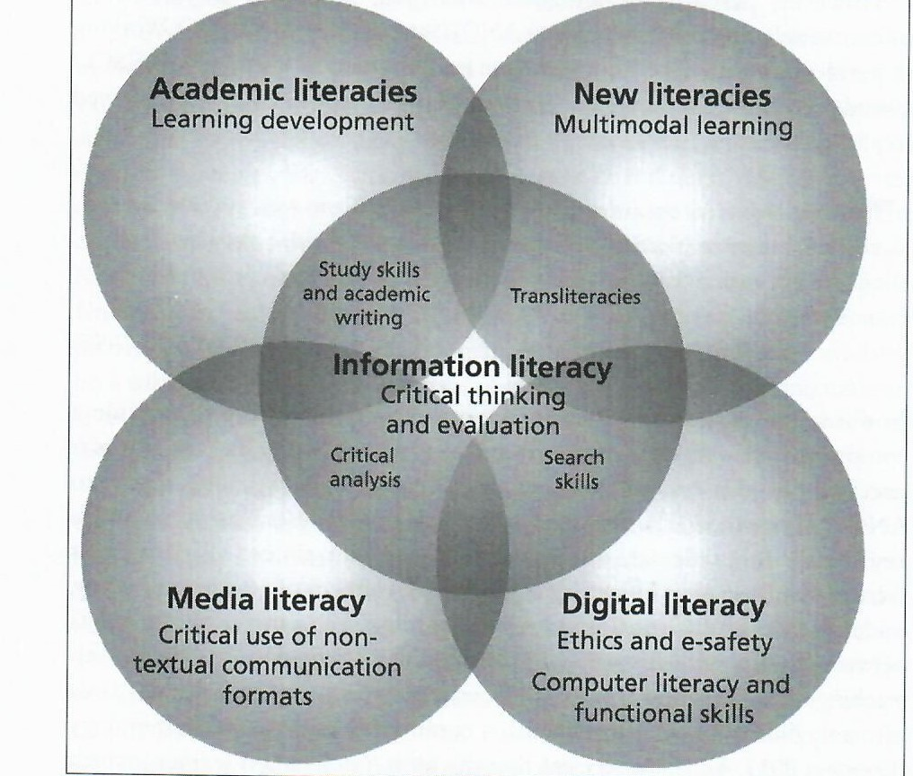
The information literacy landscape (Secker, Coonan 2013, ANCIL)

Slide 19
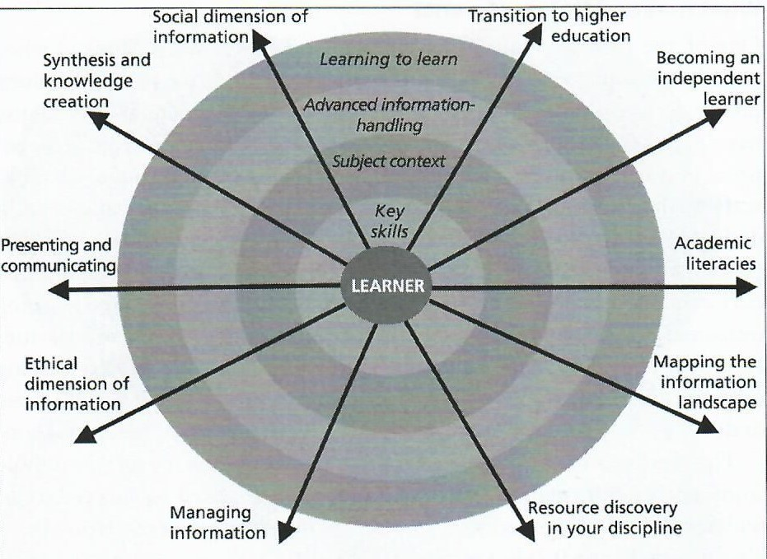
ANCIL Model of IL (Secker, Coonan 2013), ten strands

Slide 20
ANCIL model (Secker, Coonan 2013)
Strand 1 transition to higher education
Strand 2 becoming an independent learner
Strand 3 developing academic literacies
Strand 4 mapping and evaluating the information landscape
Strand 5 resource discovery in a discipline
Strand 6 managing information
Strand 7 the ethical dimension of information
Strand 8 presenting and communicating knowledge
Strand 9 synthesizing information and creating new knowledge
Strand 10 the social dimension of information
Strand 9 synthesizing information and creating new knowledge

Slide 21
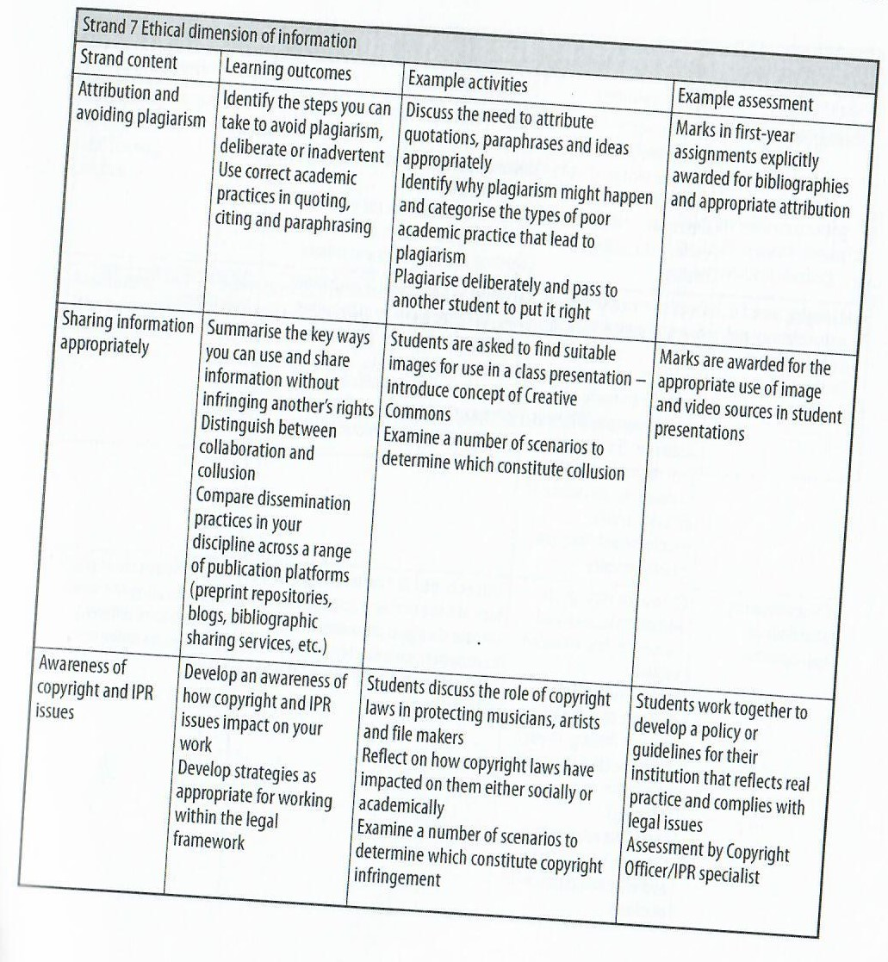
ANCIL Model (Secker, Coonan 2013)

Slide 22
Metaliteracy
Information literacy framework (pedagogical model) to prepare students to identify fake news, combination of multiple critical thinking, metacognition – reflection, lifelong learning (MacKay, Jacobson 2014)
4 domains: cognitive, behavioral, affective, metacognitive
  Characteristics: participatory, collaborative, reflective, civic-minded, adaptable, open, productive, informed
Goal 1 actively evaluate content and one´s own biases
Goal 2 engage with all intellectual property ethically and responsibly
Goal 3 produce and share information in collaborative and participatory environment
Goal 4 develop learning strategies to meet lifelong personal and professional goals

Slide 23
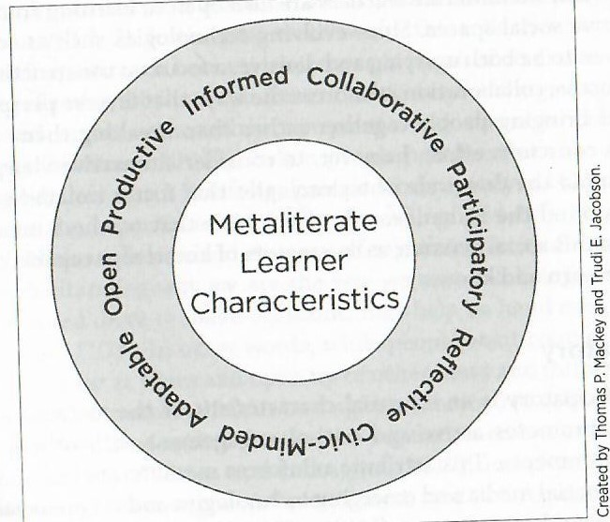
Metaliteracy (MacKay, Jacobson 2019)

Slide 24
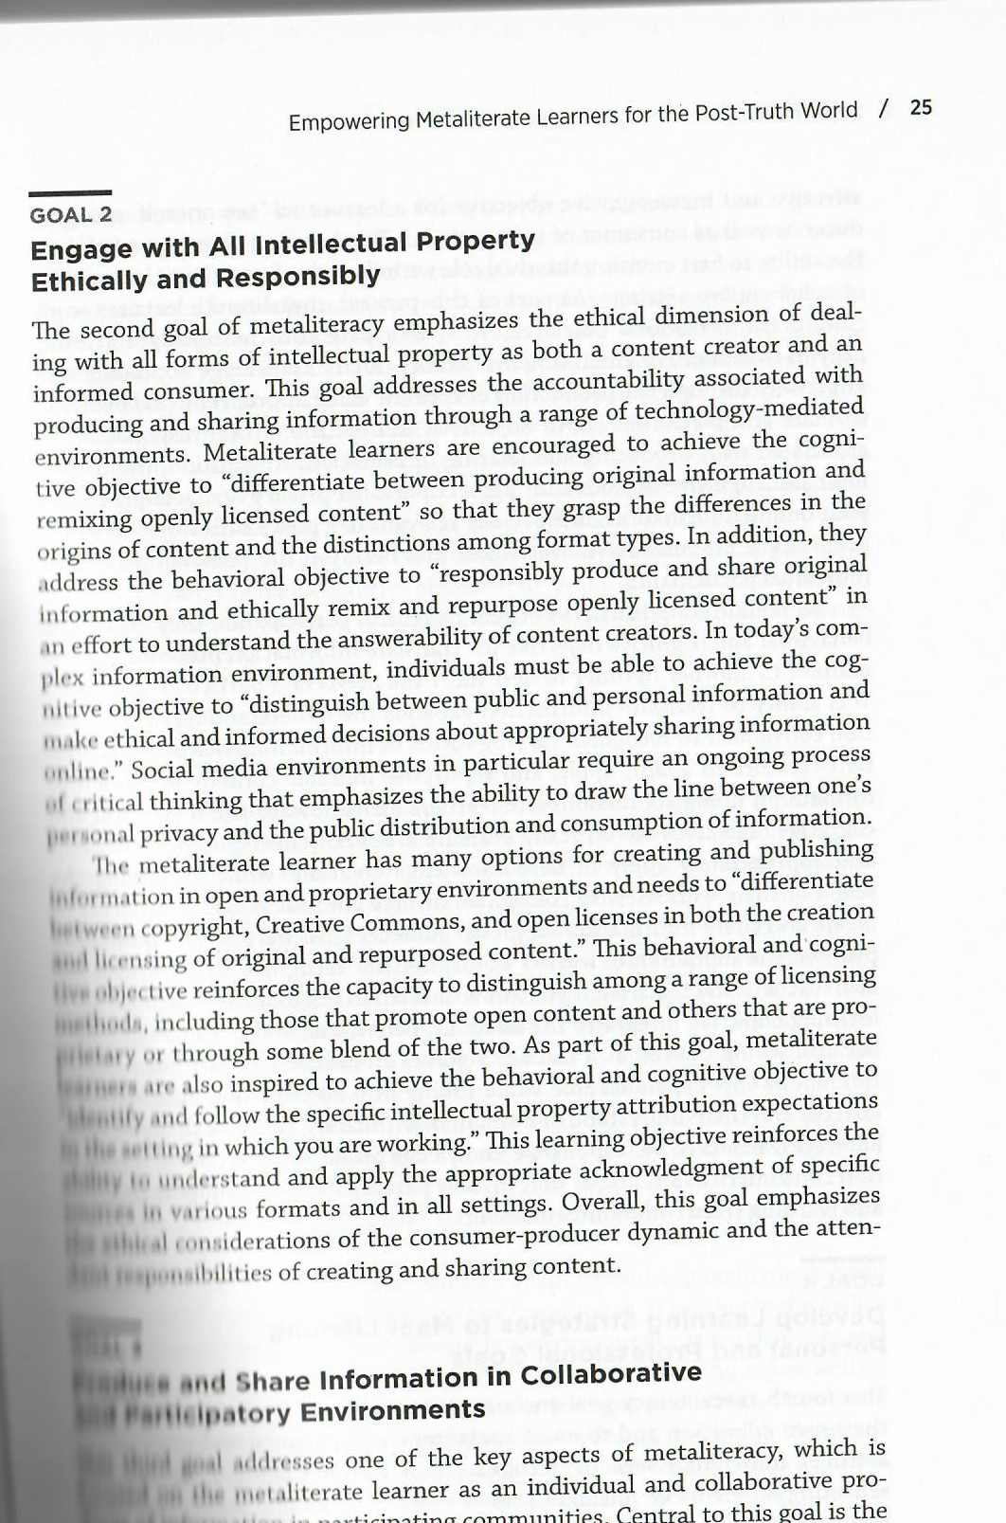
Metaliteracy (MacKay, Jacobson 2019)

Slide 25
Ethical issues and information literacy
Ethical factors: one social dimension of information literacy
  Moral literacy and information literacy: re-conceptualize information literacy, digital literacy – ethical sensitivity and imagination: assess values / virtues, rules, consequences
Ethical factors:
ethically informed use: ethical awareness of the information environment, values of information, accuracy (verification, critical thinking), fair use of information (rules, citation culture, tools)
ethically informed production of information: personal ethical factors: emotions, ethical intuitions and imagination, ethical reasoning, responsibility, ethical communication and sharing of information (rules, experience) – construction of truth , values and understanding

Slide 26
Ecological and ethical contexts of digital literacy (Steinerová 2022)
ethical access
adaptation, re-use, utilities
experience, skills,
rules, responsibility
values, emotions, ethical intuitions
Creative information exploration
Personal, community, social information ecologies

Slide 27
Research: a Delphi study (2021-2022)
Objectives: identify ethical challenges of information work, assess future
Methodology a Delphi study – a qualitative survey of expert opinions:
  Phases:
  1. a pilot study (4 experts, LIS, journalism, marketing communication, computer science)
  2. a study (19 experts, LIS, social informatics, computer science, psychology, political sicences, management, IT companies)
  3. discussion: focus group: (5 experts, informatics/ AI, philosophy, data ethics, LIS, social informatics)

Slide 28
Research statement and methodoly
Questions: What is the perception of ethical issues of information work by experts? What is their assessment of future development?
Three questions in the pilot and real online survey (4+19 experts)
  (1) „Which three ethical issues do you regard as most significant from the perspective of the present development of information ethics and why?”, (2) “Which three ethical dilemmas do you perceive as most significant with regard to ethics of artificial intelligence and information and data analyses? (Please explain the reasons for your statements)”, and (3) “Which three values of information do you regard as decisive in digital information use and why?”
Analyses: discourse analysis, constant comparative analyses, conceptual modelling: conceptual models

Slide 29
A pilot study: results: a concept model
social rules (ethical codices)
utility
truth
responsibility
education information literacy

Slide 30
Results: main issues of information ethics in the digital environment
privacy and personal data
protection
information technologies and artificial intelligence
human governance, quality of data
benefits for people, transparency
disinformation
accuracy of information
false news, verification of truth, information literacy
security

Slide 31
Results: main ethical dilemmas of advanced technologies and AI
impact on human life
personal data, decision-making, checking
monitoring, commercialization
bias of algorithms
transparency, explainability, interpretability
decision-making
control and human management
limitations of freedom and democracy

Slide 32
Results: main values of information
utility
cognitive development
truthfulness
verification
credibility
objectivity
responsibility
critical thinking
topicality

Slide 33
A final conceptual model: social representations of ethics of digital information
education
organizations
everyday information
research
workplace processes
Social and cultural contexts
Conflict of values: people and technologies
Truth, utility, objectivity of information
use of information
creation of information
communication of information

Slide 34
Conclusions: recommendations
Inclusion of ethical factors into models: enrich conceptual understanding
Value-added design of information systems, search, products
Ethically informed human information behaviour and information literacy
    Discern of dis/misinformation, social perception, social diffusion
    Privacy, personal data, personal / academic / research integrity
    Access and AI: ethical sensitivity and ethical awareness of information interactions (as opposed to platforms, commercial searching service)

Slide 35
Conclusions: ethically informed use and production of information
Add ethical factors into models of HIB and information literacy
  ethical intuitions – emotions, truth (verification), responsibility, virtue ethics (values), utilitarian (tools) and consequential ethics (rules)
Cultivate (in education and information literacy): ethical sensitivity, ethical awareness of information use
Ethical and ecological re-design of information services, products, systems: ethical reasoning, ethical problem-solving, decision-making
Information ecologies: adaptations, value-sensitive use and production of information, re-use of resources, co-evolution

Slide 36
References
AGARWAL, N.K. (2022). Integrating models and integrated models: towards a unified model of information seeking behavior. In: Information Research, Vol 27, No. 1, March 2022. paper 922. Retrieved from http://InformationR.net/ir/27-1/paper922.html (Archived by the Internet Archive at https://bit.ly/3t0XoXA https:doi/10.1108/AJIM-01-2021-0034/full/html
AGARWAL, N.K. and Alsaeedi, F. (2021). Creation, dissemination and mitigation: toward a disinformation behavior framework and model. In: Aslib Journal of Information Management, Vol. 73, No. 5, 639-658. https://www.emerald.com/insight/content/doi/10.1108/AJIM-01-2021-0034/full/html
BAWDEN, D. and L. ROBINSON, 2020. The dearest of our possessions: Applying Floridi´s information privacy concept in models of information behavior and information literacy. In: Journal of the Association for Information Science and Technology. 2020, 1–14. DOI: 10.1002/asi.24367.
CAPURRO, R., 2019. Ethical Issues of Humanoid-Human Interaction. In: Ambarish Goswami and Prahlad Vadakkepat (eds.). Humanoid Robotics: A Reference. Springer: Dordrecht 2019, 2421-2435. Available from: https://link.springer.com/referenceworkentry/10.1007%2F978-94-007
CAPURRO R. and Ch. PINGEL, 2002. Ethical Issues of Online Communication Research. In: Ethics and Information Technology. 2002, 4 (3), 189–194. [cit. 2022-07-24]. Available from: https://link.springer.com/referenceworkentry/10.1007%2F978-94-007-6046-2_127.
FLORIDI, L., 2013. The Ethics of Information. Oxford: Oxford University Press. ISBN 9780199641321.
KARLOVA, N. A. and K. E. Fisher, 2014. A social diffusion model of misinformation and disinformation for understanding human information behavior. In Information Research, 18(1) paper 573. Available from: http://InformationR.net/ir/18-1/paper573.html.
KELLY, M. and J. Bielby (eds.), 2016. Information Cultures in the Digital Age. A Festschrift in Honor of Rafael Capurro. Wiesbaden: Springer 2016. 479 s. ISBN 978-3-658-14679-5. http://www.capurro.de/onres.htm.-6046-2_127.

Slide 37
References
MACKAY, T. P. and T. R. JACOBSON, 2019. Metaliterate Learning for the Post-truth World. Chicago: ALA 2019. 230 p. ISBN 978-0-8389-1776-3.
LLOYD, A., 2021. The Qualitative Landscape of Information Literacy Research. Perspectives, Methods and Techniques. London: Facet 2021. 152 p.
NARDI, B. and V. O´DAY, 1999. Information Ecologies: Using Technology with Heart. Cambridge: MIT Press. ISBN 978-02-626-4042-8.
RUOKOLAINEN, H. and G. WIDÉN, 2020. Conceptualisation of misinformation in the context of asylum seekers. In Information Processing and Management, Vol. 57, (3), 102–127. Available from: https://doi.org/10.1016/j.ipm.2019.102127.
RUSHO, Y and D. RABAN, 2019. Hands on: Information Experiences as Sources of Values. Journal of the Association for Information Science and Technology. 71 (6), 671–684. DOI: https://doi.org/1.1002/asi.24288
SECKER, J. and E. COONAN, 2013. Rethinking Information Literacy: A Practical Framework for Supporting learning. London: Facet 2013.
SECKER, J., 2011. A New Curriculum for Information Literacy: Expert Consultation Report [online]. Cambridge University Library. [cit. 2012-07-24]. Available from: http://ccfil.pbworks.com/f/Expert_report_final.pdf.
SECKER, J., 2017. The trouble with terminology: rehabilitating and rethinking “Digital Literacy”. In: Reedy, K. and Parker, J. (eds.). Digital Literacy Unpacked. London: Facet 2017, 3–16. ISBN 178330197 X.

Slide 38
References
MARCHIONINI, G., 2008. Human-information interaction research and development. In: Library and Information Science Research. Vol.30 (3), 165-174.
STAHL B. C., 2021. Artificial Intelligence for a Better Future. An Ecosystem Perspective on the Ethics of AI and Emerging Digital Technologies. London: Springer 2021.
STEINEROVÁ, J., 2014. Informačná etika v súvislostiach informačnej ekológie. Knihovna. 2014, roč. 25, č. 1, 23–35. Available from: http://knihovna.nkp.cz/knihovna141/141023.htm. ISSN 1801-3252.
STEINEROVÁ, J. and M. ONDRIŠOVÁ, 2020. Informačná veda. Výkladový slovník. Bratislava: Vyd. UK 2020. 278 s. ISBN 978-80-223-4866-9.
STEINEROVÁ, J. 2020c. Etika digitálnych informácií vo svetle sociálnych hodnôt informácií. In: ITLib. Roč. 24, č. 2 (2020), 6–21. ISSN 1335-793X.
STEINEROVÁ, J., 2022a. Etické faktory informačných interakcií človeka. In: Knihovna: knihovnická revue. 2022. 33 (1), 5-29. ISSN 1801-3252. Available from: https://knihovnarevue.nkp.cz/.
STEINEROVÁ, J., 2022b. Ecological and Ethical Contexts of Digital Literacy in the Light of Phenomenographic Studies. In: Information Literacy in a Post-Truth Era. Eds. S. Kurbanoglu, S. Špiranec, Y. Ünal, J. Boustany, D. Kos. 7th European Confer. on Inform. Literacy, ECIL 2021 Rev. Selected Papers. Cham: Springer Nature 2022, 157-166. ISBN 978-3-030-99884-4. Available from: https://doi.org/10.1007/978-3-030-99885-1,

Slide 39
References
TOWNSEND, L., HOFER, A.R., HANICK, S.L. and K. BRUNETTI, 2016. Identifying Threshold Concepts for Information Literacy: A Delphi Study. Communication in Information Literacy, Vol. 10. (1), 23–49. Available from: https://doi.org/10.15760/comminfolit.2016.10.1.13.
TUANA, N., 2007. Conceptualizing Moral Literacy. In: Journal of Educational Administration. Vol.45, (4), 364–378. Available from: http://site.ebrary.com/lib/uniba/reader.action?docID=10196373.
WALTON, G., POINTON, M., BARKER, J., TURNER, M. and A. Wilkinson, 2021. Information discernment and the psychophysiological effects of misinformation. Global Knowledge, Memory and Communication.
WHITWORTH, A., 2020. Mapping Information Landscapes. New methods for exploring, development and teaching of information literacy. London: Facet 2020. 201 s.
ZINS, Ch., 2007. Conceptual Approaches for Defining Data, Information, and Knowledge. In JASIST, vol. 57, No. 4, 479–483. Available from: DOI: 10.1002/asi.20508. ISSN 2514-9342.

Slide 40
References
ACRL, 2016. Framework for Information Literacy for Higher Education. In: American Library Association. 1996–2019. [online]. Association of College and Research Libraries [cit. 2022-07-11]. Available from: http://www.ala.org/acrl/standards/ilframework
BRUCE, Ch. (2016). Information Literacy Research: Dimensions of the Emerging Collective Consciousness, Australian Academic & Research Libraries, 47:4, 220-238, DOI: 10.1080/00048623.2016.1253423
BRUCE, C., Sommerville, M., Stoodley, I. Partridge, H. (2013). Diversifying Information Literacy Research: An Informed Learning Perspective. In: Hepworth, M., Walton, G. (eds.). Developing People´s Information Capabilities: Fostering Information Literacy in Educational, Workplace and Community Contexts, 223-440. Emerald, London.
CAPURRO, R. (2005). Information Ethics. In: CSI Communications, 2005, 7-10.
FORSTER, M., 2013. Information literacy as a facilitator of ethical practice in the professions. Journal of Information Literacy, 7, (1), 18–29. [cit. 2022-07-24]. Available from: http://dx.doi.org/10.11645/7.1.1783.
FORSTER, M., 2017 (ed.). Information Literacy in the Workplace. London: Facet 2017. 189 s. ISBN 978-1-78330-132-4.
FOUNDATIONS of Information Ethics. (2019). Ed. By J. T.F. Burgess, E.J.M. Knox. London: ALA, Facet 2019. 156 A.
FRIEDMAN, B. a N.G Freier, 2005. Value Sensitive design. In: Fisher et al (eds.). Theories of Information Behavior. Medford: Information Today, 2005, 368-272.

Slide 41
References
FALLIS, D., 2015. What is Disinformation? In: Library Trends, 2015, Vol. 63, No. 3, 401–426. Available from: 10.1353/lib.2015.0014
Steinerová, J. (2010). Ecological dimensions of information literacy. In: Information Research, 15(4). Accessed at: http://InformationR.net/ir/15-4/colis719.html
Fázik, J. and J. Steinerová. (2020). Technologies, knowledge and truth: the three dimensions of information literacy of university students in Slovakia. In: Journal of Documentation, Vol. 77 No. 1, 285-303. Accessed at: https://doi.org/10.1108/JD-05-2020- 0086
LEWANDOWSKY, S., U. K. H. ECKER and J. COOK, 2017. Beyond Misinformation: Understanding and Coping with the “Post-truth” Era. Journal of Applied Research in Memory and Cognition. Vol. 6 (4), 353–369. Available from: doi: 10.1016/j.jarmac.2017.07.008.
Lloyd, A.M. (2010). Information Literacy Landscape: Information literacy in education, workplace and everyday contexts. Chandos Publishing, Oxford.
LLOYD, A., 2021. The Qualitative Landscape of Information Literacy Research. Perspectives, Methods and Techniques. London: Facet 2021. 152 p.
Steinerová, J. (2018). Informačné prostredie a vedecká komunikácia: Informačné ekológie. Bratislava: Univerzita Komenského v Bratislave. 276 p. ISBN 978-80-223-4445-6. 229 s.
Steinerová, J. (2018). Perceptions of the information environment by researchers: a qualitative study. In Proceedings of ISIC, Information Research, 23(4), paper isic1812, Accessed at: http://www.informationr.net /ir/23-4/isic2018/isic1812.html

